Slide 1
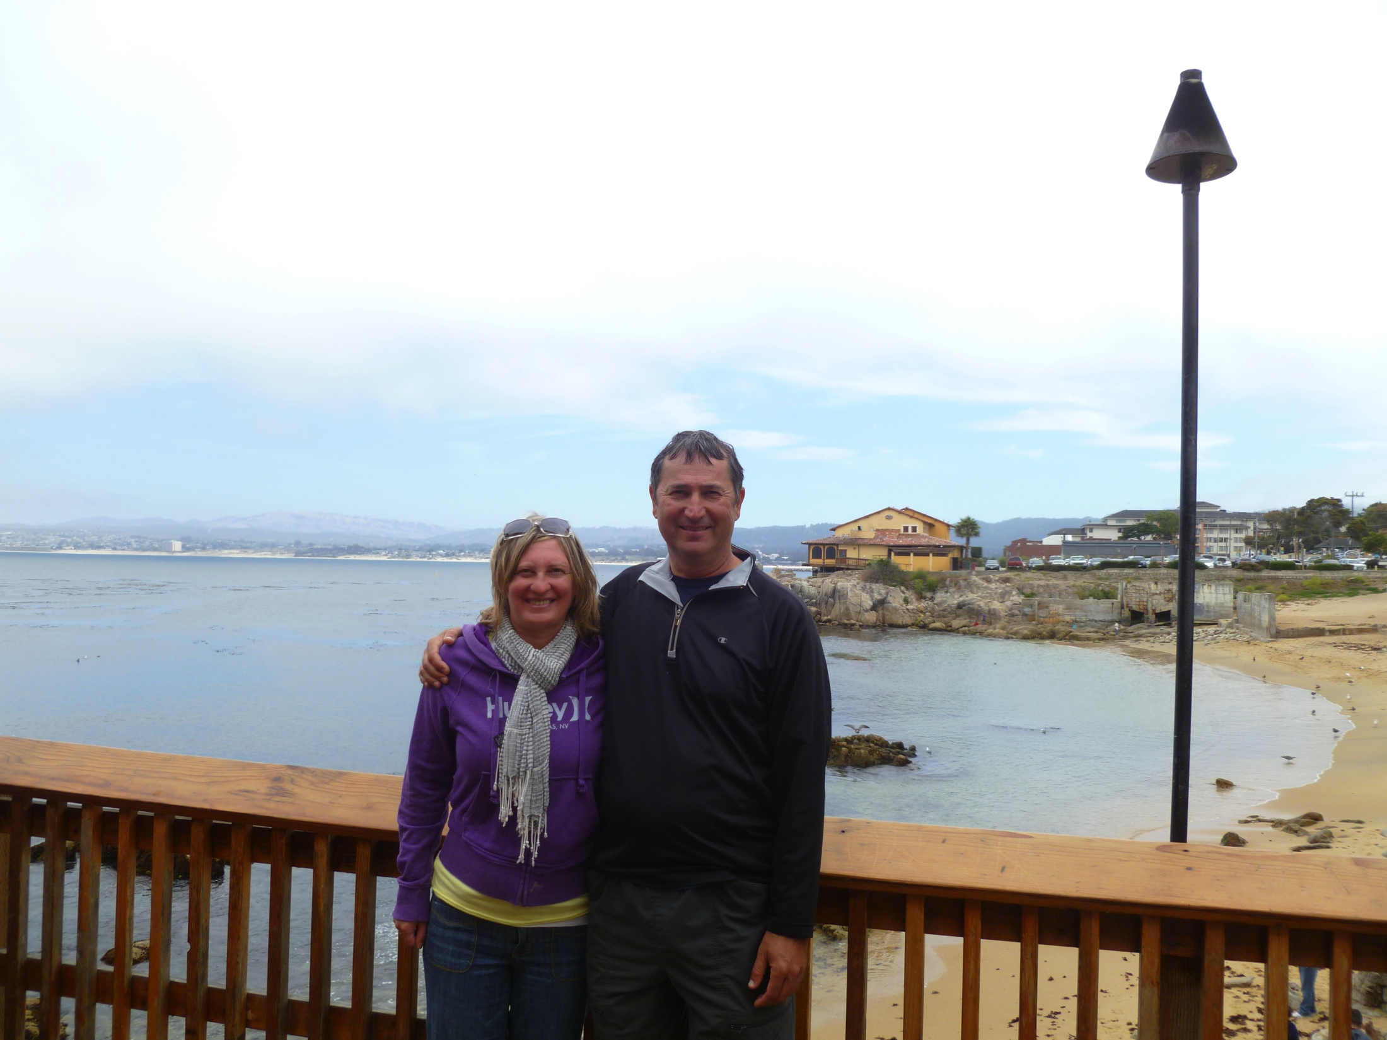
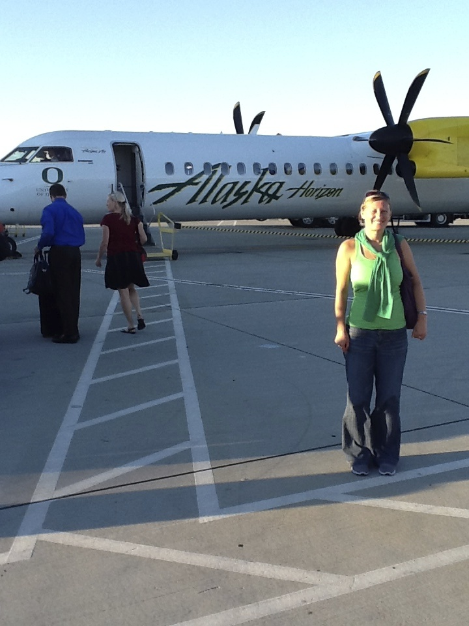
Mr. and Mrs. Pop Introduction Welcome Students and Parents 2016 – 2017 World History Class
Summer Time , Hobbies , Tennis

Slide 2
Tennis is my Sport. Indian Wells Tennis Tournament

Slide 3
Mr. Pop, concentrating and preparing to serve in Phoenix, Arizona National Finals

Slide 4
2015 - USA National Men’s Champions

Slide 5
Mr. Pop Teaching High School at Mira Loma High School for 16 years

Slide 6
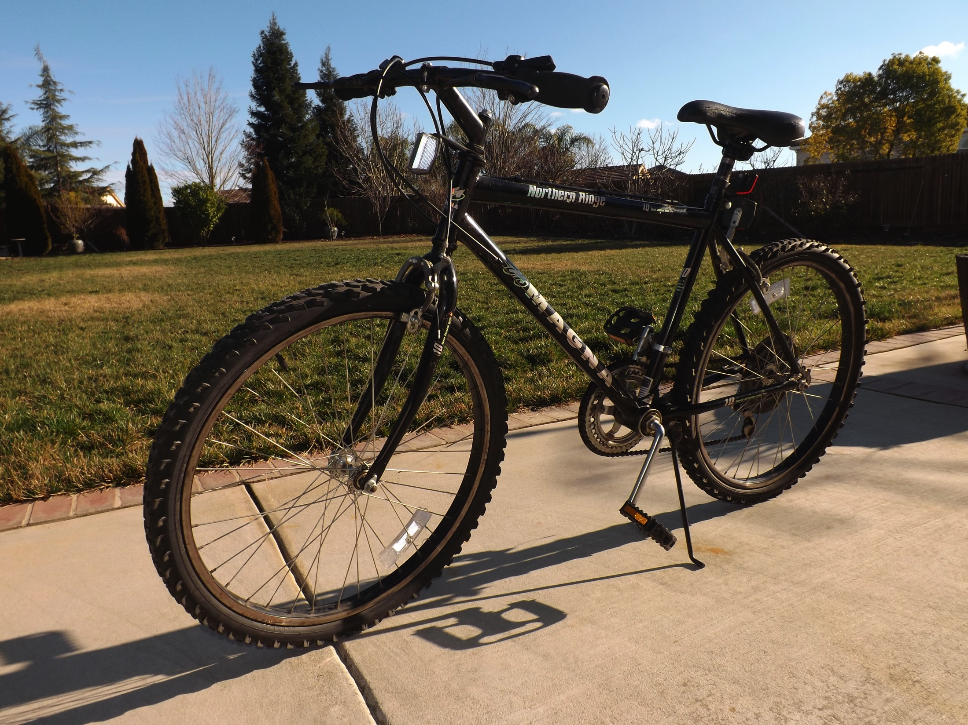
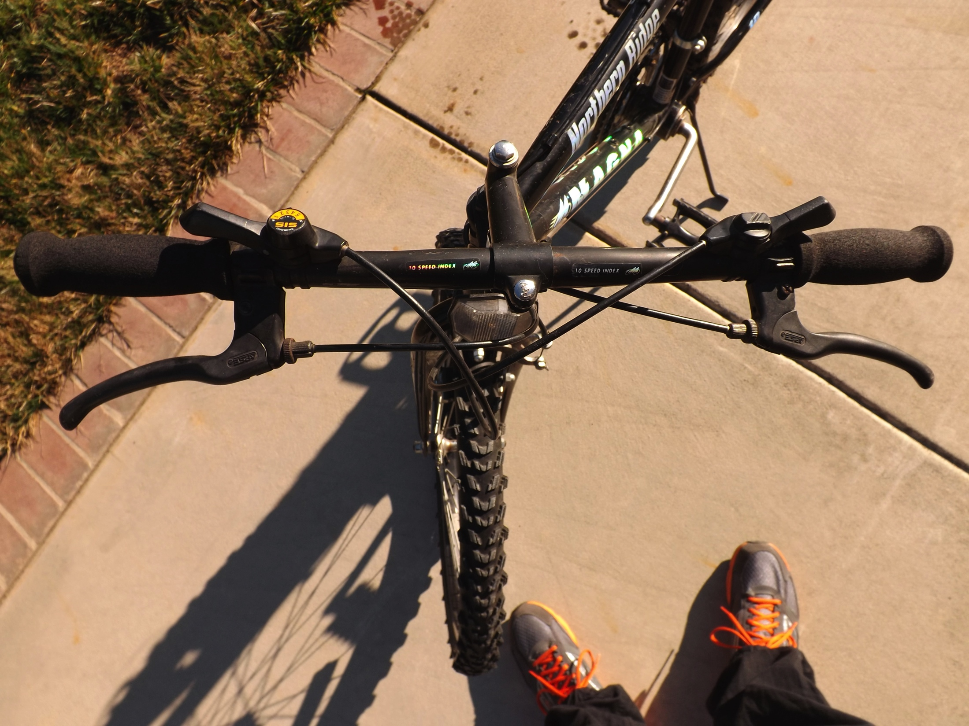
More Bikes Raffled of in Mr. Pop’s Class

Slide 7
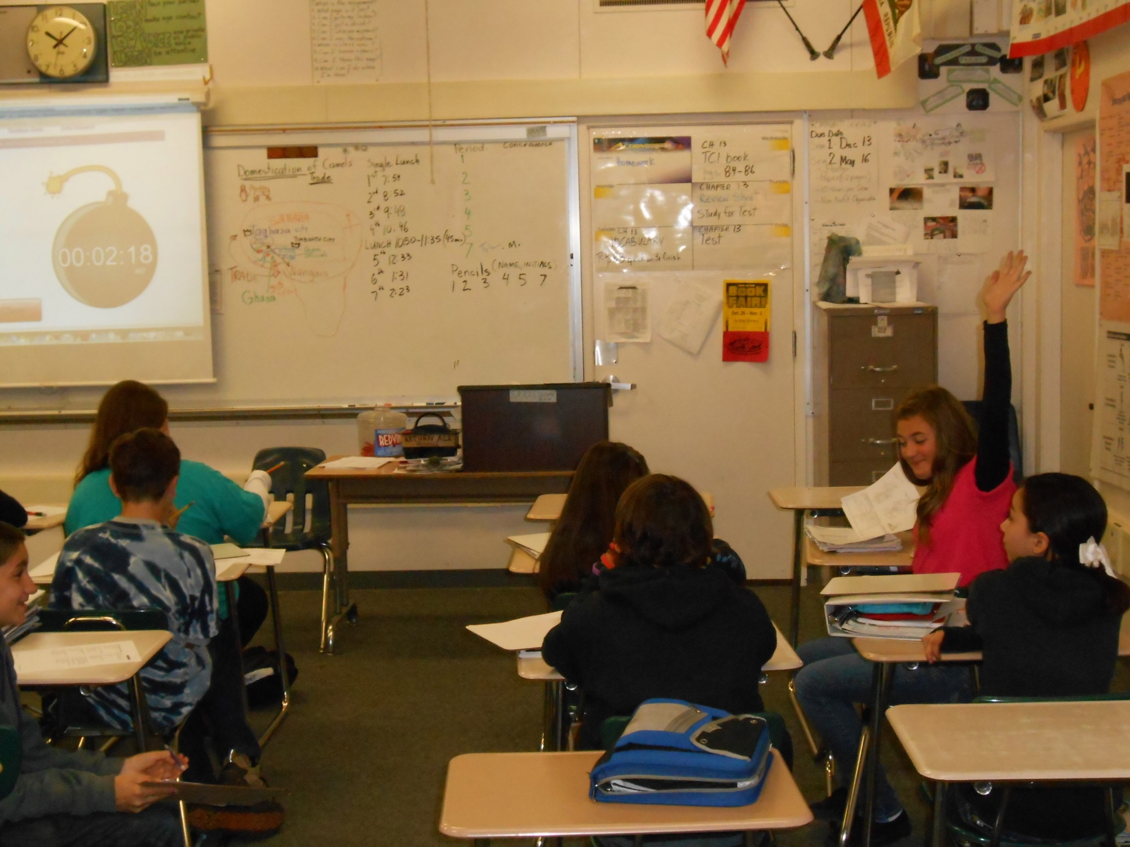
Welcome to the World History Class - 2015 – 2016 School Year
THE END

